Slide 1
Baylor T3 (Train the Teacher)
Entrepreneurship Education for High School Teachers
z

Slide 2
Baylor Entrepreneurship T3
z
z
Catalyst for Baylor T3 was the Baylor Youth Entrepreneur Awards which launched in 2014. This is our 2017 group of award winners.
Working with Chris Holecek and Judy York from ESC Region 12 on BYEA, we began to see a need for this class.
www.Baylor.edu/business/YEA

Slide 3
2017 Baylor Youth Entrepreneur Awards 1st Place Winner – Brennan Agranoff
z
z
Founded HoopSwagg, LLC when he was 13
$3,000 investment from parents
Attended Sherwood High School in Sherwood, Oregon
Sold over $1 million in custom socks in 2017

Slide 4
2017 Baylor Youth Entrepreneur Awards 2nd Place Winner – Ehan Kamat
Started his company 321 Innovations LLC in 2015 at age 15. First product was the Solemender
Reusable, cold foot massager for treating plantar fasciitis invented by Ehan when he was 12.
His mother suffered from plantar fasciitis.
Start-up cost funded by family
Holds patent and sells through eleven local stores in St. Louis, Mo.

Slide 5
2017 Baylor Youth Entrepreneur Awards 3rd Place Winner – Addison Bain
z
z
Started Addigrams in 2015 at the age of 15
Won as a sophomore at Midway High School in Waco
Offers custom monograms and embroidery as well as unique merchandise through her Etsy site.
Will be a freshman at Baylor in Fall, 2018

Slide 6
Baylor Entrepreneurship T3
Designed around the TEKS for Entrepreneurship adopted in 2015
Unique values-based, experiential learning focus
Each Session 15 hours (15 CPEs)
$400 per session (meals, course materials included)

Slide 7
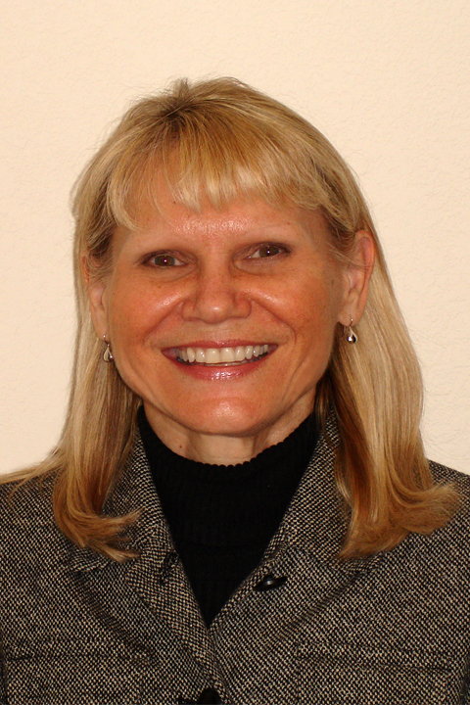
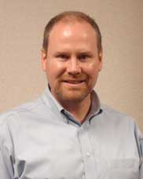
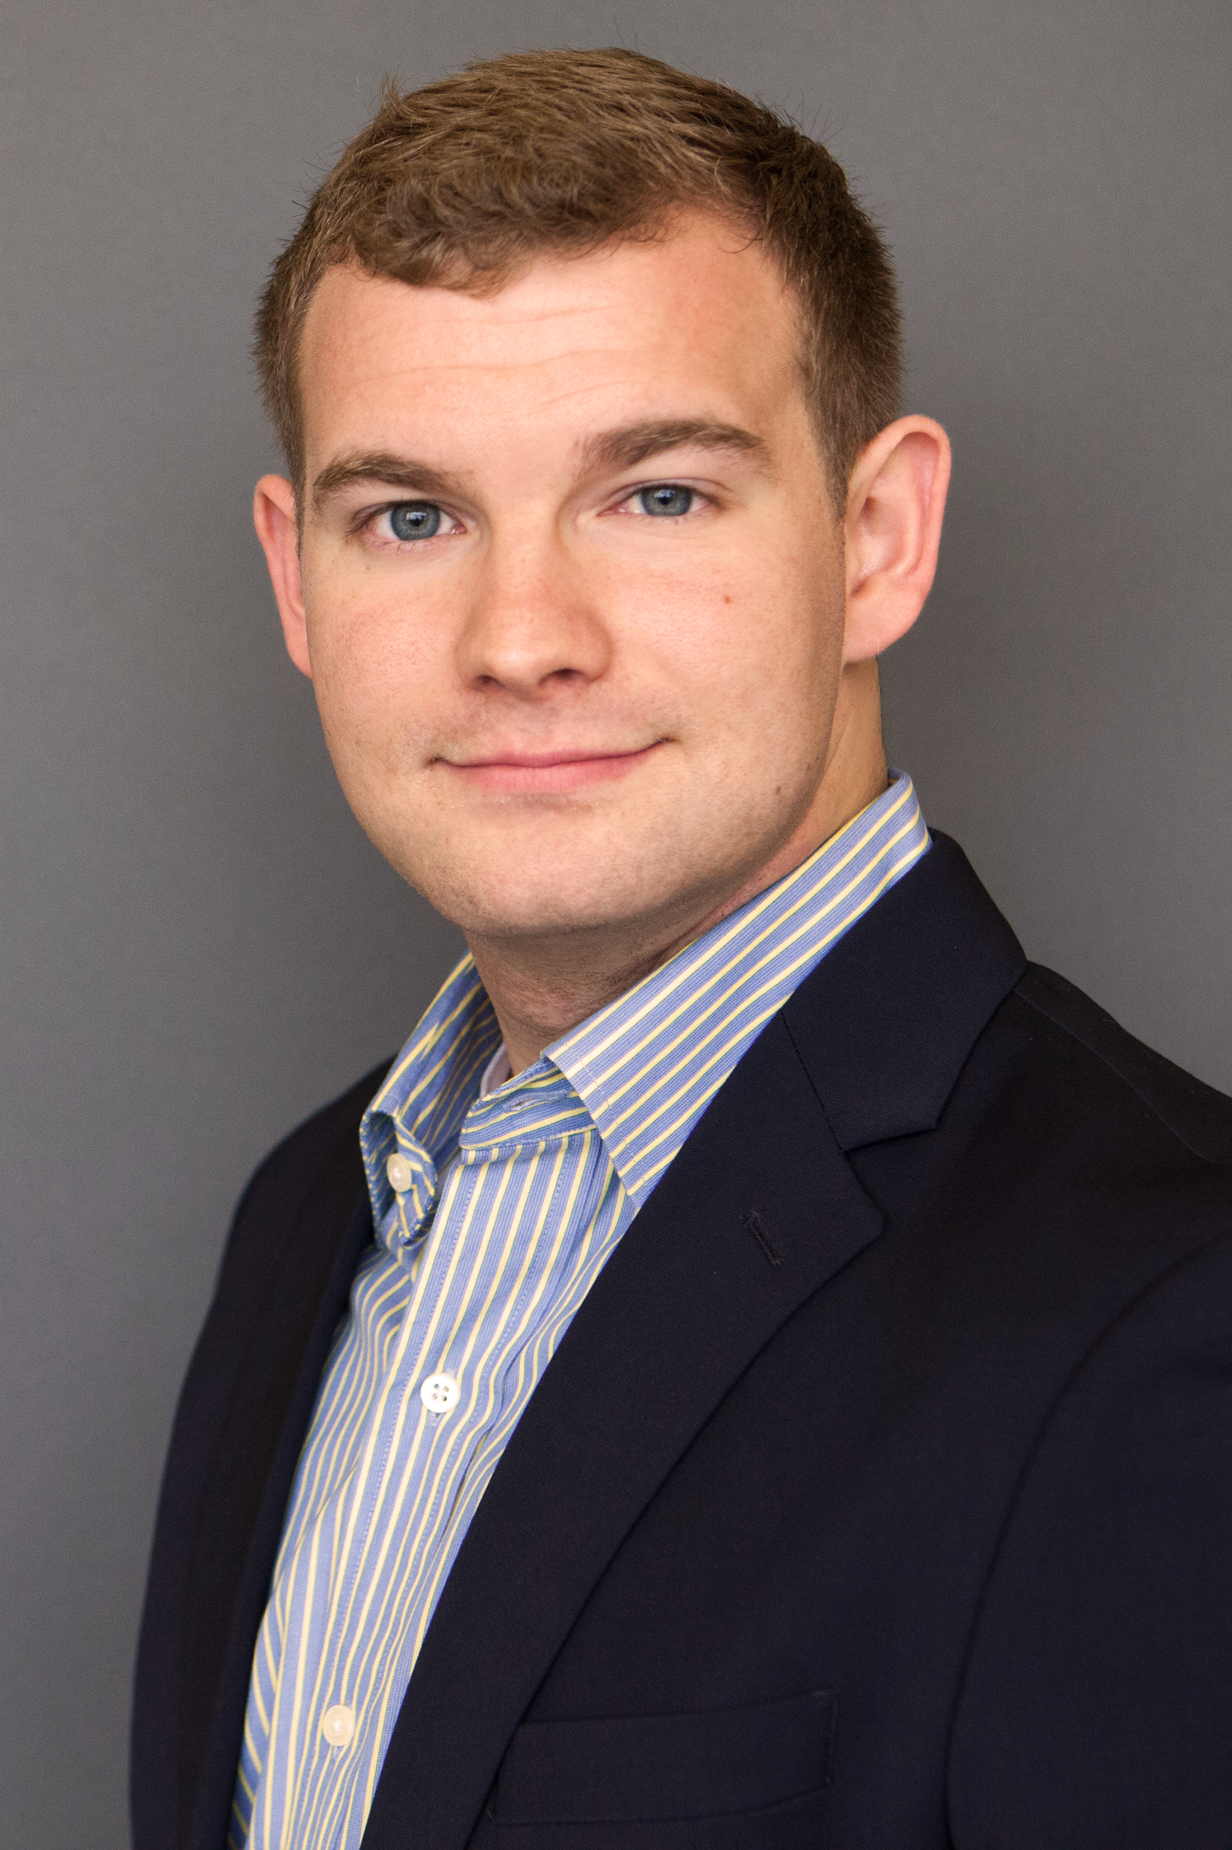
Baylor T3 Instructors
Dawn Maitz: Mrs. Maitz is a consultant and business trainer with experience working with entrepreneurs through training programs like Kaufmann Foundations’ Fast Trac program and as associate director of the Baugh Center for Entrepreneurship at Baylor University.
Bradley Norris: Bradley R. Norris, MSM is Senior Lecturer in Baylor University’s Hankamer School of Business Entrepreneurship Department. In addition, he is the Director of Technology Entrepreneurship Initiatives. He holds a bachelors in Artificial Intelligence, Information Systems Design and Math from Indiana University in addition to a Masters of Science in Management from Purdue University.
Gib Reynolds: Mr. Reynolds is a serial entrepreneur in the sustainable food production space. Gib has launched family operated ventures and currently teaches classes geared toward student entrepreneurs at Baylor. Gib is a graduate of Baylor and The Acton School in Austin, TX.

Slide 8
June 4-7, 2018
Baylor Entrepreneurship and Region 12 ESC
In conjunction with The Connect3 Conference
Choose to experience one or both two-day sessions
Visioneering, June 4th and 5th
Implementation June 6th & 7th
Each session offers 15 hours of instruction, inspiration and classroom resources
Taught by Baylor faculty and practicing entrepreneurs
z

Slide 9
Baylor Entrepreneurship T3
Visioneering-June 4
Visioneering – June 5
Introduction to Entrepreneurship and Ideation
Ideation, the Feasibility Study and Business Plan
Forecasting Financial Requirements
Funding a Startup
Who is my Market and Who is my Competition
What is my Unique Proposition
The Promotional/Marketing Plan
Social Responsibility
Business Law and Types of Legal Organizations
The Regulatory Environment

Slide 10
Baylor Entrepreneurship T3: Implementation
Implementation - June 6
Implementation - June 7
Building a Successful Business Organization
Financial Statements
Understanding Credit
Pricing Policies
Product Management
Product Planning
Distribution
Purchasing
Entrepreneurial Risk
Panel Discussion Feedback

Slide 11
Registration
Register through Region 12 ESC
Connect3 Conference
“Visioneering” June 4 & 5
“Implementation” June 6 & 7
All Classes meet in the Foster Campus for Business & Innovation, Room 416
Contact: Linda Ramirez, Program Coordinator, Baylor T3, Linda_Ramirez@Baylor.edu, 254-710-4157

Slide 12
Baylor Entrepreneurship is…
z
z
#5 Ranked Entrepreneurship Undergraduate Program by Entrepreneur Magazine/The Princeton Review (2017)
#9 Ranked Entrepreneurship Undergraduate Program by U.S. News & World Report (2017)
Publishers of the #1 selling small business textbook for each of the past 50 years, Small Business Management: Launching and Growing Entrepreneurial Ventures(Longenecker, Petty, Palich, Hoy)

Slide 13
z
z
Contact Chris Holecek Education Specialist
254-297-1284 cholecek@esc12.net

